Slide 1

CSS Selectors
01
02
Introduction
03

Slide 2
Content
01
CSS Units
02
CSS Selectors Dive
03
Box Model

Slide 3
01
CSS Units

Slide 4
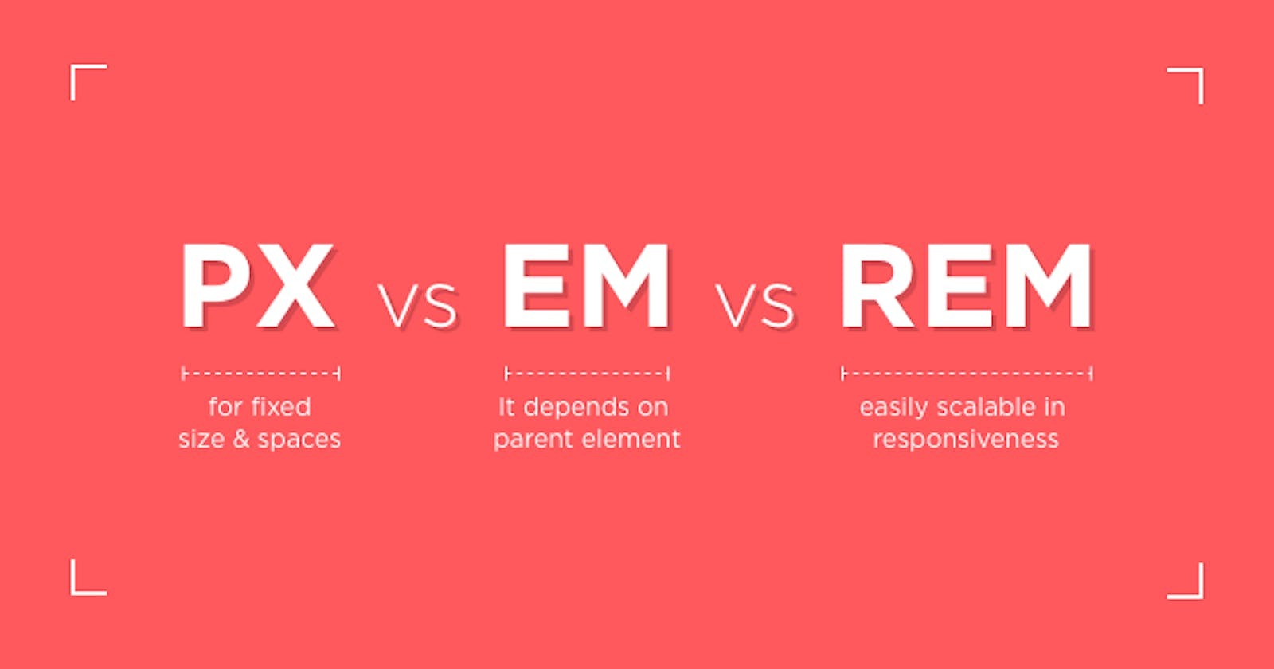
PX vs EM vs REM
https://smazee.com/blog/css-units-px-em-rem-vh-vw-vmin-vmax

Slide 5
PX`s and Percentage
Pixels:
Easiest unit that we can use because
Div with 500px width will be 500px from the page size and it will not change with changing the screen size.
If the user changes the font size of the browser, there will be no effect on the font size in our application - because we`ve set it in pixels.
Percentages:
See the direct parent and based on that handle the size of the element.
We have 2 divs. Parent div's width is 60% and child div's width is set to 50%.
The child takes 30% of the original page size.

Slide 6
EM`s
Are called EM because they approximate the size of an uppercase letter M.
If I had a div of font-size: 16px, the child element would be 1em = 16px
The em is always dependent on its parent.
In 6-point type, 1 em is 6 points;
In 12-point type, 1 em is 12 points;
In 60-point type, 1 em is 60 points;
One em space is proportionately same in any size.

Slide 7
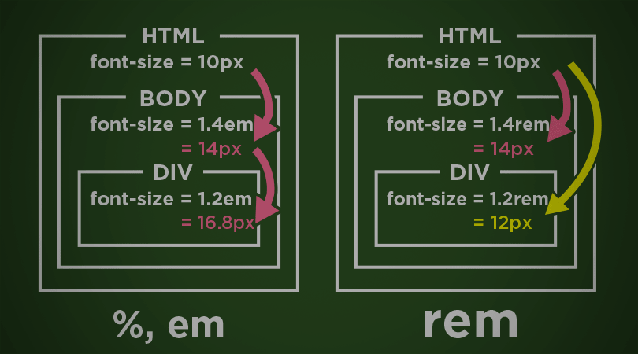
REM`s
Values are relative to the root HTML element, not to the parent element
If I have the root element of 16px, then 1rem = 16px
If the font is not specified in the root element, then 1rem will equal the default value provided by the browser(usually 16px).

Slide 8
02
CSS Selectors

Slide 9
CSS Selectors
In CSS, selectors are used to target the HTML elements on our web pages that we want to style.
There are a wide variety of CSS selectors available, allowing for fine-grained precision when selecting elements to style. A CSS selector is the first part of a CSS Rule.
https://developer.mozilla.org/en-US/docs/Learn/CSS/Building_blocks/Selectors

Slide 10
Type selectors
Matches elements by node name.
It selects all elements of the given type within a document.
https://developer.mozilla.org/en-US/docs/Web/CSS/Type_selectors
[tag-name] {
[declaration]
[declaration]
}
h1 {
color: blue;
font-weight: bold;
}

Slide 11
Class selectors
Matches elements based on the contents of their class attribute.
https://developer.mozilla.org/en-US/docs/Web/CSS/Class_selectors
.[tag-name] {
[declaration]
[declaration]
}
.[class-name]{
color: blue;
font-weight: bold;
}

Slide 12
ID selectors
Matches an element based on the value of the element's id attribute. For the element to be selected, its id attribute must match exactly
https://developer.mozilla.org/en-US/docs/Web/CSS/ID_selectors
#[tag-name] {
[declaration]
[declaration]
}
#[id-name]{
color: blue;
font-weight: bold;
}

Slide 13
Attribute selectors
Matches elements based on the element having a given attribute explicitly set, with options for defining an attribute value or substring value match.
https://developer.mozilla.org/en-US/docs/Web/CSS/Attribute_selectors
[attribute="value"] {
[declaration]
[declaration]
}
[href="example.com"]{
color: blue;
font-weight: bold;
}

Slide 14
Universal selector (*)
Matches elements of any type.
https://developer.mozilla.org/en-US/docs/Web/CSS/Universal_selectors
* {
[declaration]
[declaration]
}

Slide 15
CSS Combinators
Descendant combinator
The descendant combinator — typically represented by a single space (" ") character — combines two selectors such that elements matched by the second selector are selected if they have an ancestor element matching the first selector.
https://developer.mozilla.org/en-US/docs/Web/CSS/Descendant_combinator
header p {
color: blue;
font-weight: bold;
}

Slide 16
CSS Combinators
Selector list
The CSS selector list (,) selects all the matching nodes. A selector list is a comma-separated list of selectors.
https://developer.mozilla.org/en-US/docs/Web/CSS/Selector_list
header, p, div {
color: blue;
font-weight: bold;
}

Slide 17
CSS Combinators
Child combinator
The child combinator (>) is placed between two CSS selectors.
Matches only those elements matched by the second selector that are the direct children of elements matched by the first.
https://developer.mozilla.org/en-US/docs/Web/CSS/Child_combinator
header > p {
color: blue;
font-weight: bold;
}

Slide 18
Exercise Selectors
CSS Diner:
https://flukeout.github.io/
W3School Exercises:
https://www.w3schools.com/css/exercise.asp
HTML & CSS Guidebook Exercises:
https://htmlandcssguidebook.com/quizzes/css-selectors

Slide 19
03
Box Model
What is Box Model?

Slide 20
What is Box Model?
The browser's rendering engine represents each element as a rectangular box.
CSS determines the size, position, and properties (color, border size, etc.) of these boxes.
https://developer.mozilla.org/en-US/docs/Learn/CSS/Building_blocks/The_box_model

Slide 21
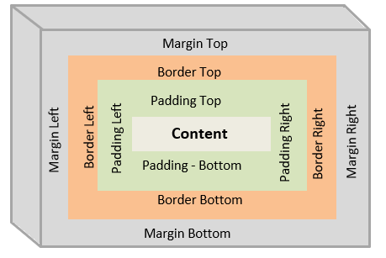
The Box Model

Slide 22
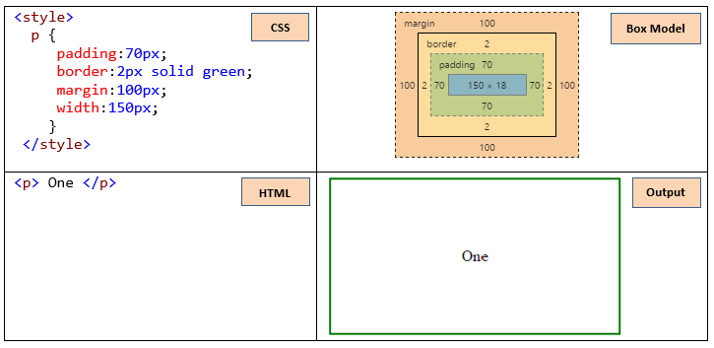
The Box Model

Slide 23
Box Model – CSS Properties
Display
Defines the display type of an element, which consists of the two basic qualities:
the outer display type defining how the box participates in flow layout
the inner display type defining how the children of the box are laid out.

Slide 24
Box Model – CSS Properties
display: block;
Browsers display the block-level element with a newline before and after the element.
display: inline;
Only occupy the space bounded by the tags defining the element
display: inline-block;
Can use vertical padding and margin on inline elements and adding width and height.

Slide 25
Box Model – CSS Properties
width
The width CSS property sets an element's width.
By default, it sets the width of the content area
https://interactive-examples.mdn.mozilla.net/pages/css/width.html
min-width
Sets the minimum width of an element.
max-width
Sets the maximum width of an element.

Slide 26
Box Model – CSS Properties
height
Specifies the height of an element.
https://interactive-examples.mdn.mozilla.net/pages/css/height.html
min-height
Sets the minimum height of an element.
max-height
Sets the maximum height of an element.

Slide 27
Box Model – CSS Properties
margin
Sets the margin area on all four sides of an element.
Shorthand for margin-top, margin-right, margin-bottom, and margin-left.
https://interactive-examples.mdn.mozilla.net/pages/css/margin.html
border
Sets an element's border.
Shorthand for border-width, …-style, and …-color.
https://interactive-examples.mdn.mozilla.net/pages/css/border.html
padding
Sets the padding area.
Shorthand for padding-top, …-right, …-bottom, and …-left.
https://interactive-examples.mdn.mozilla.net/pages/css/padding.html

